Slide 1

Plant Anatomy Lecture 4
Plant Histology and Anatomy (part 1)

Slide 2
Plant histology and ANATOMY Anatomy
Introduction
Histology is a branch of biology that deals with the study of tissues.
Tissue is a group of similarly specialized cells having common origin, structure and function.
Anatomy is a branch of biology that deals with the study of internal structure of organ and organ systems.
As we know that all organisms are made up of cells and their organization starts from A cellular, Cellular, Tissue level, to the higher organ system level.
In plants, based on the capacity of division/ growth, the plant tissues are classified in to two major groups, namely the Meristem and the Permanent tissues.

Slide 3
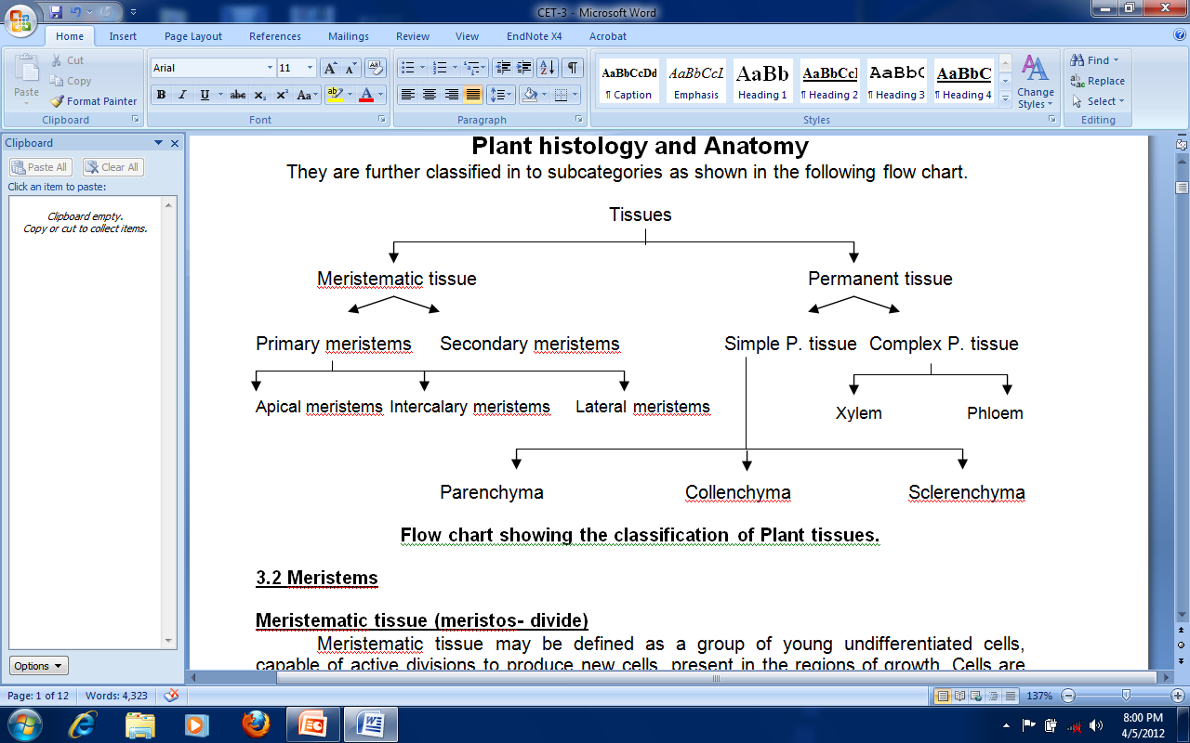


Slide 4

Meristems
Meristematic tissue (meristos- divide)
Meristematic tissue may be defined as a group of young undifferentiated cells, capable of active divisions to produce new cells, present in the regions of growth. Cells are compactly packed with thin cell wall made from Cellulose, cytoplasm is dense without vacuoles, nucleus is prominent, plastids and ergastic substances are absent.
They bring about growth, differentiation and involved in the healing process.

Slide 5
Based on the position, they are classified in to
Apical meristems: They are found at the tips/apices of roots, shoots and bring about the increase in vertical length (primary growth).
Intercalary meristems: They are found in inter nodal regions (as in grasses) or at the leaf bases (as in Pinus). It is also responsible for primary growth. E.g. Bamboo, Sugar cane etc
Lateral meristems: They are found along the lateral sides of the permanent tissues in the stem and roots of dicotyledons and gymnosperms. They are absent in monocots. They are responsible for increase in girth of the organ (Secondary growth). Vascular and Cork cambium are the examples.

Slide 6
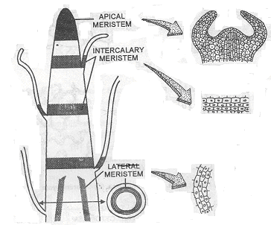


Slide 7
Based on the origin, they are classified in to
Promeristems/ Primordial/ Embryonic meristems: These are earliest, embryonic meristematic cells occupying a small area and give rise to new tissues and organs.
Primary meristems: These meristems are derived from the promeristems and retain the capacity to divide through out life of the plant. They persist through out life. They are found at the tips of roots, stems and primordia of leaves.
Secondary meristems: these are derived from primary permanent tissues by a process called dedifferentiation. It takes place during secondary growth.

Slide 8
Based on the function, they are classified in to
Protoderm meristem: it is the outer most layer of the Apical meristem; in future differentiate to form epidermal tissue system.
Ground meristem: it lies between the protoderm and procambium. It forms ground tissue.
Procambium: it is a part of apical meristem develops in to primary vascular tissues, namely xylem, phloem and cambium.

Slide 9
Permanent tissues
Permanent tissues may be defined as a group of cells, derived from meristems after differentiation, growth and maturation, characterized by definite shape, size and function.
Classification of Permanent tissues
Based on the cell types the Permanent tissues are classified in to Simple Permanent tissues and Complex Permanent tissues.
Simple Permanent tissues: SPT as group of similar cells having common functions. They are further classified in to three types:
Parenchyma
Collenchyma and
Sclerenchyma.

Slide 10
Parenchyma: it is the ground/ fundamental/ living tissue generally found in soft parts of the plants of all categories.
Distribution: Soft regions such as cortex and pith of root and stem, mesophyll of leaves, fleshy parts of fruits, endosperm of seeds etc.
Structure: They are thin walled, iso-diametric, shape variable, with definite nucleus and vacuolated cytoplasm and certain large amount of food materials.
Classification of Parenchyma: Based on the cell structure and function, three types of parenchyma are noticed:-

Slide 11
Simple parenchyma: Ground tissue possesses all the characters as above. These cells show essential metabolic functions like respiration, secretion, excretion and also storage.
Idioblasts: Parenchymal cells containing mineral crystals like Raphides (Oils, crystals of Calcium oxalate).
Chlorenchyma: Parenchymal cells containing chloroplasts usually found in the cells of leaves and some times the cells of stem cortex.
Palisade parenchyma: these are elongated chlorenchymal cells as in leaves.
Spongy parenchyma: These are irregularly shaped chlorenchymal cells with large intercellular spaces.
Aerenchyma: The parenchymal cells with large intercellular air filled spaces (Helps in Buoyancy and exchange of gases), usually found in aquatic, submerged and very few land plants.
Prosenchyma: slightly thick walled elongated parenchymal cells.

Slide 12
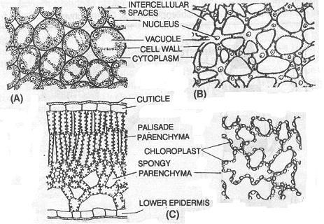
Functions of Parenchyma:
They take part in the vital functions like photosynthesis, respiration, secretion etc.
They are involved in the storage of Starch, Proteins, Crystals etc.
They are involved in the storage of water as in Xerophytes (Opuntia (الصبارة), Aloe etc.).
Aerenchyma with large intercellular air spaces helps in buoyancy(الطفو).
They are involved in healing of wounds and take part in regeneration.

Slide 13
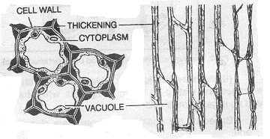
Collenchyma: It is a simple living permanent tissue found in the hypodermal regions of the plant body
Distribution: present below the epidermis (hypodermal region). It also occurs in leaves on either sides of vein and normally absent in leaf mesophyll underground storage.
Structure
Cells living appear cylindrical in vertical section and oval, globular or polygonal in cross section. More compactly packed, nucleus at corners and vacuolated cytoplasm. Cell wall uniformly thin except at corners, where in corners, the secondary wall is thickened with cellulose, hemi cellulose or pectin.

Slide 14
Types of Collenchyma:
Based on the Pectinization and arrangement of cells the Collenchyma is classified in to three types
Angular Collenchyma: Cells are irregularly arranged, compactly packed and only the corners of the cells are pectinised. E.g. Datura, Ficus, Morus (التوت) etc.
Lamellar Collenchyma: Cells are compactly packed and pectin is deposited layer by layer in Collenchyma. E.g. Sunflower.
Lacunar Collenchyma: Cells are with small intercellular spaces and pectin gets deposited in there spaces rarely. E.g. Malva(الخبيزه), Salvia(نبات الناعِمه أو القويضه), Hypodermis of cucurbita (القرع).
Functions
It functions as primary mechanical tissue and give support to young aerial parts of dicots particular Petioles, Pedicel and fruit stalk.
Like parenchyma it also takes place in wound healing process.
Collenchyma contains chloroplasts that take part in photosynthesis.
It protects the vascular bundles of leaves by forming Bundle caps.
It gives support to the developing organs of the plant.

